Slide 1
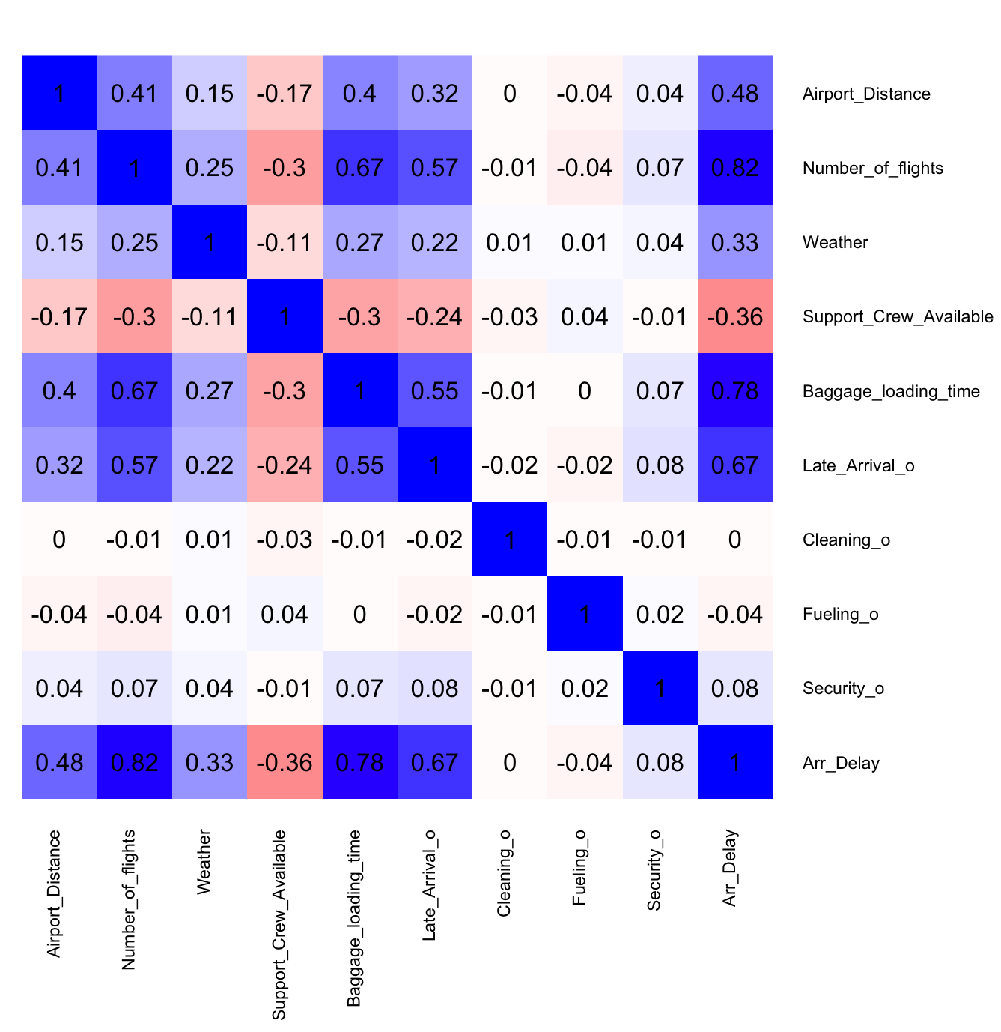
Exploratory Data Analysis 3
Correlations
A heatmap was added to this model to better visualize the correlation between all variables.
Number of flights, Baggage loading time, and Late arrivals are most correlated with Arrival Delay. The variables hold the most association with one another compared to other independent variables as well.
Because of an extremely high correlation coefficient, we can assume some collinearity is present in the variable Number of fligths, as well possibly in Baggage loading time. It may be better to include these variables in a new model where they act as our y.
When looking at the low coefficients for variables like Cleaning, Fueling and Security, we can assume these variables hold little impact on flight arrival time, and that other variables may currently be actively adjusted to keep these three variables from experiencing delay. These variables may require the time they take to be completed with quality and safety, therefore remain unchanged, shifting the time compromise onto other variables.

Slide 2
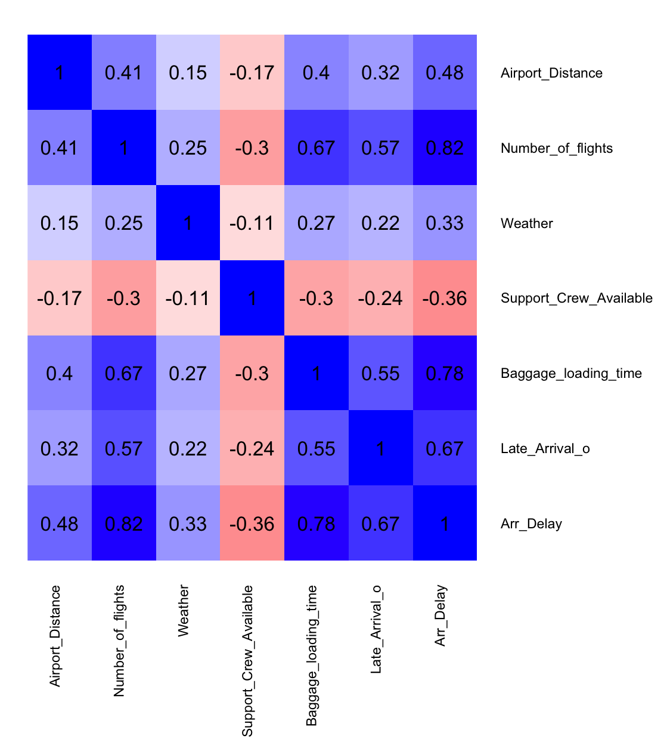
Variables Selection
Variables were selected based on EDAs 1-3, followed by a Multiple Linear Regression model inclusive of all variables (initial_lm_model). The first draft model included all variables, but non-significant predictors were removed.
The most significant variables were Airport distance, Number of flights, Weather, Support crew available, Baggage loading time & Late arrival of previous flight. .
The second linear model (final_lm_model) applies variable selection in efforts of building a better model.
Variables Cleaning time, Fueling time & Security time were dropped, because they lacked significance compared to other variables.

Slide 3
Model Building & Interpretation; Training Data
To ensure model accuracy, the dataset was split into 70% training and 30% testing data.
Training Data: The training dataset consists of the historical data used to build and train the model. This data teaches the model to understand how the different variables are affecting flight delays by recognizing underlying patterns and trends present between them.
Test Data: The testing dataset contains flight data built based on our training sets patterns and trends. This data mimics new or future scenarios, to help us to get an understanding of how well the model will perform on real-life conditions to come.
By training the model on a portion of the data, we can assess its accuracy on unseen data, which helps prevent overfitting—a scenario where the model learns noise or overly specific details from the training set. This approach allows us to validate how well the model predicts real-world flight delays, ensuring it performs reliably on new data.

Slide 4
Methodology; Multiple Linear Regression Equation
Listed below are the equations defining the functional specification (Eqn. 1), population regression equation (Eqn. 2) and sample regression equation (Eqn. 3).
y | Arr_Delay
x1 | Number_of_flights
x2 | Airport_Distance
x3 | Weather
x4 | Support_Crew_Available
x5 | Baggage_loading_time
x6 | Late_Arrival_o
Variables Key
Eqn. 1. | y = f(x1, x2, x3, x4, x5, x6)
Eqn. 2. | y = a + β1x1 + β2x2 + β3x3 + β4x4 + β5x5 + β6x6
Eqn. 3. | y = a + b1x1 + b2x2 + b3x3 + b4x4 + b5x5 + b6x6
The objective of this model is to evaluate the association or lack thereof between these
independent variables and the dependent variable.

Slide 5
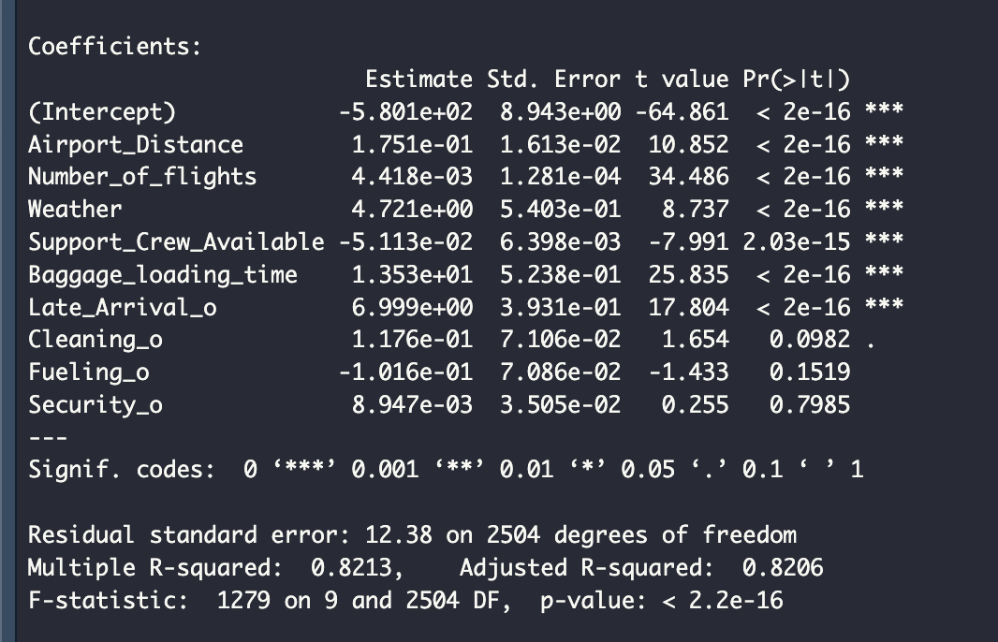
Model Diagnosis
Goodness-of-Fit Test: The R-squared and Adjusted R-squared values show how much of the variance in flight delays is explained by the model.
Standard Error: Shows the absolute measure of distance that the data points fall from the regression line
Residual Plots: Scatterplots of residuals are checked to ensure randomness and confirm that the model fits the data appropriately. No significant violations of linear regression assumptions.
Multiple R-squared = 0.8213
Adjusted R-squared = 0.8206

Slide 6
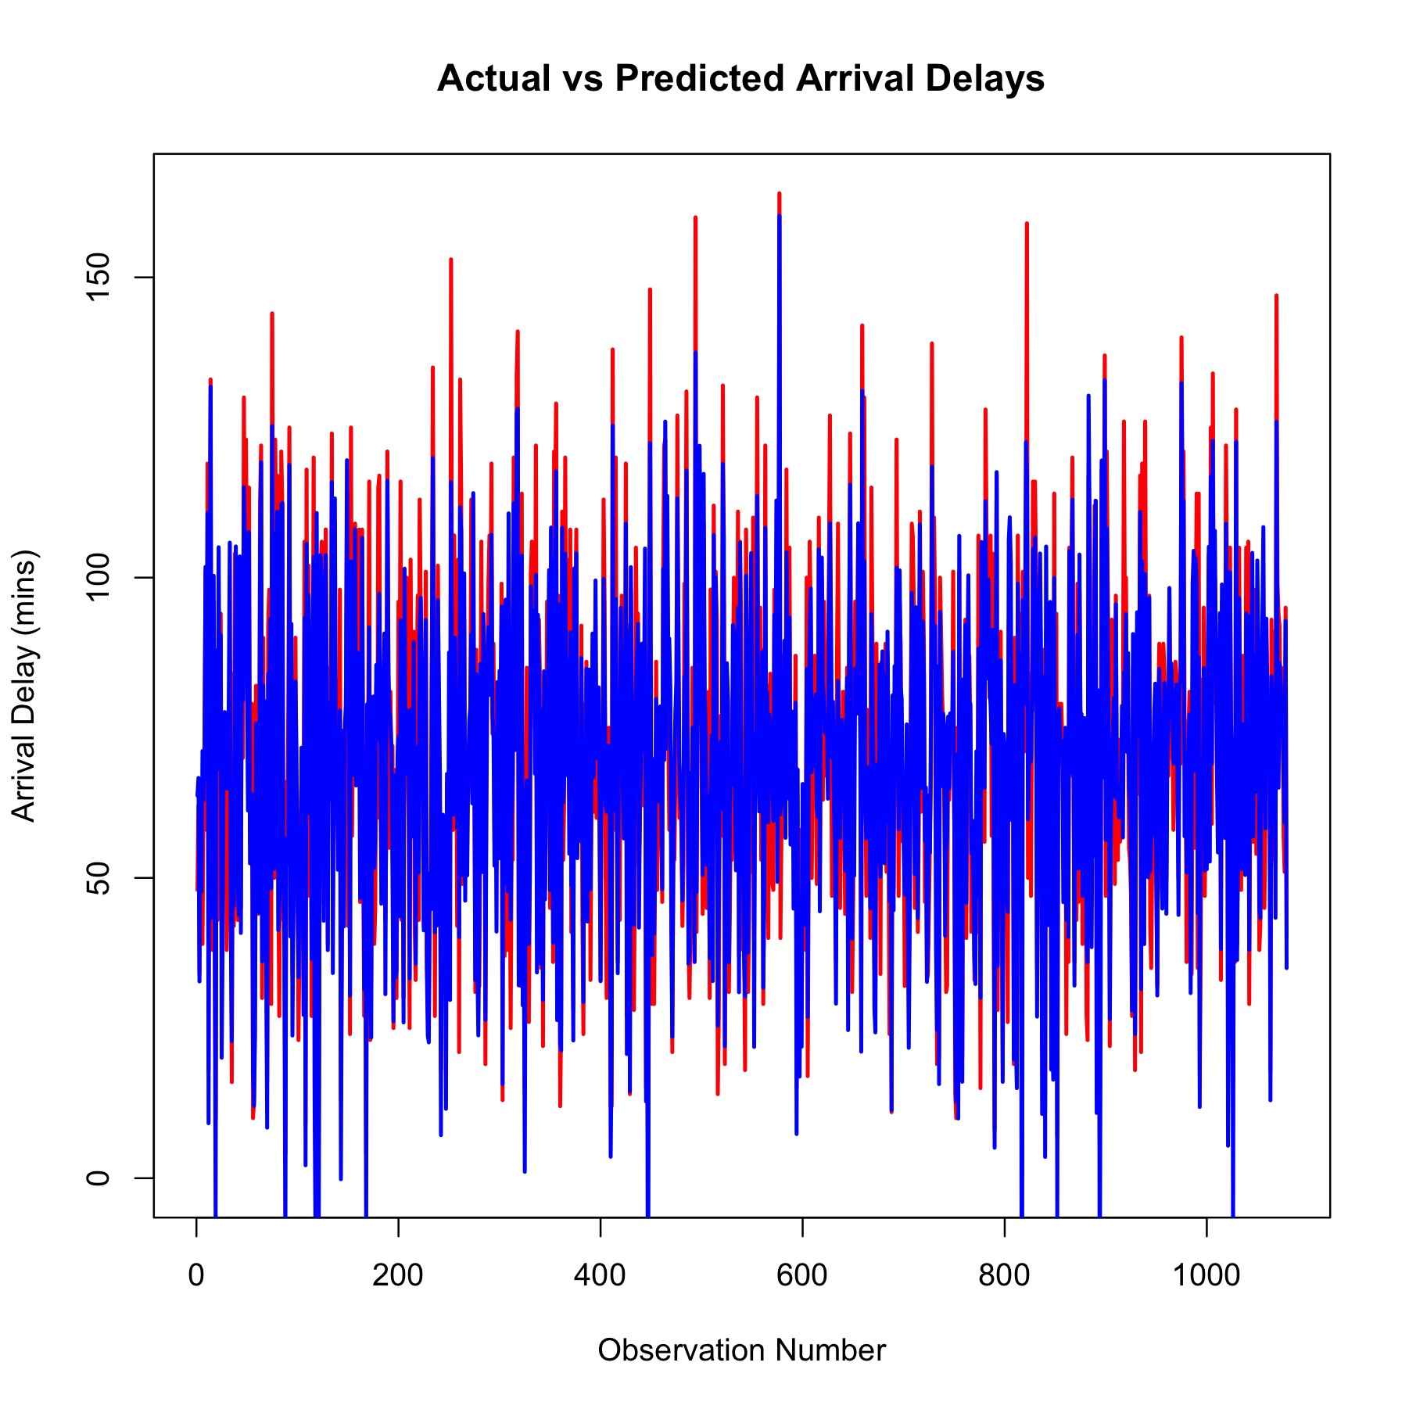
Model Prediction on Test Data
The Actual vs. Predicted plot provides a visualization of how well our regression model predicts arrival delays compared to the real or actual observed delays. The red line represents the actual arrival delays, while the blue line represents the predicted delays from the regression model.
By plotting the predicted values against the actual values, we can see that the model's predictions on the test data closely match the trends learned from the training data. This indicates that the model generalizes to the test data well and accurately captures the underlying patterns on unseen data.
The predicted values closely matched actual values in the test set, showing minimal deviation and indicating a well-fit model.

Slide 7
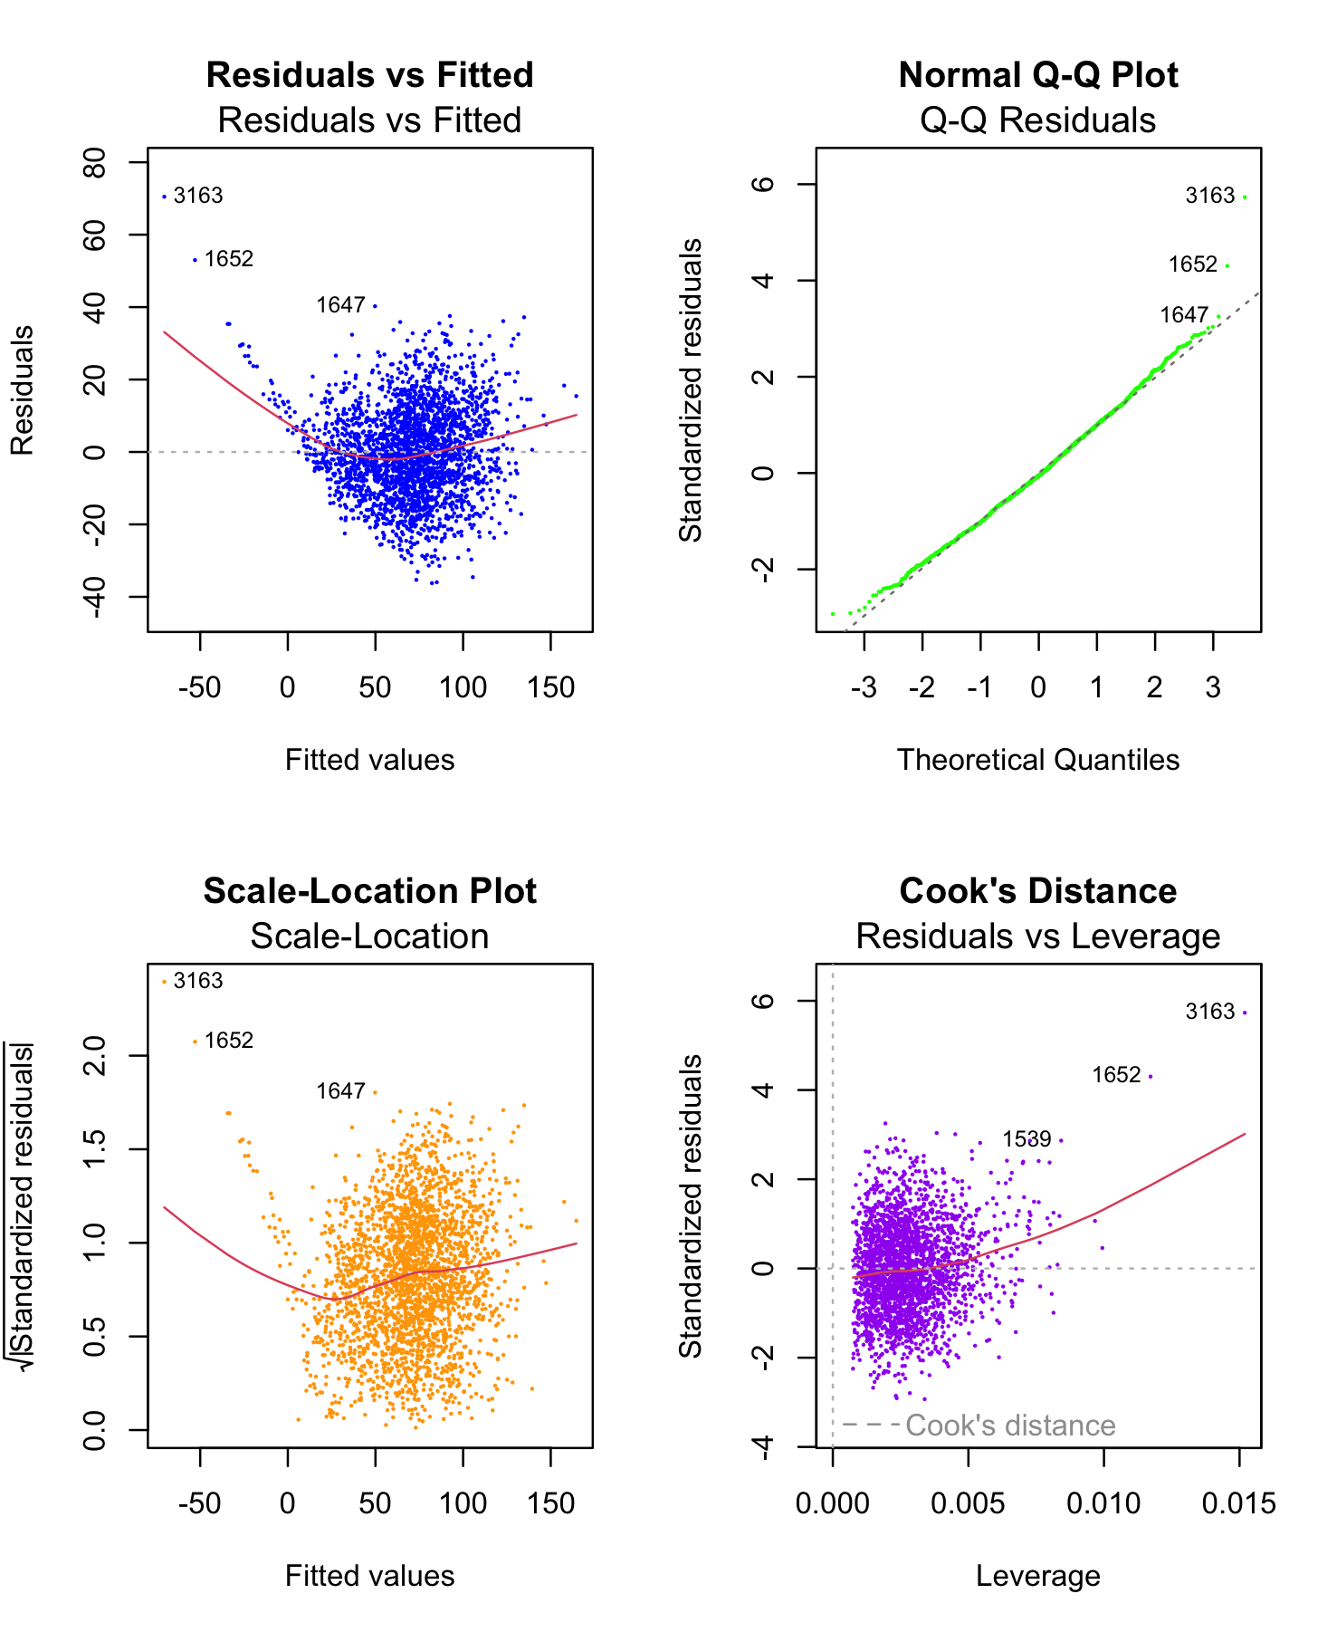
Model Assumptions
Linearity: Residual's vs. Fitted Plot
Normality: QQ Plot
Homoscedasticity: Scale- Location Plot
Influential Points: Cook's Distance

Slide 8
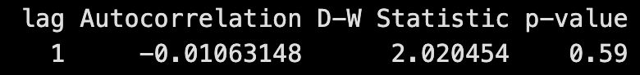
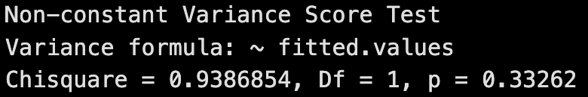
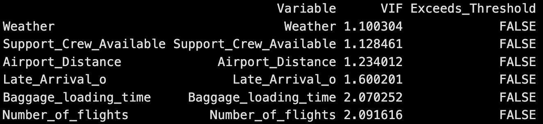
Assumption Testing
Durbin-Watson Test
Although this dataset is not time-series, the Durbin-Watson test was applied because the data may follow a natural order, such as being collected in sequence (consecutive flights or events). This test helps to detect any potential correlation between residuals from successive data points. With a D-W statistic of 2.02 and a p-value of 0.59, the results indicate no significant autocorrelation, meaning the residuals are independent. While this is a positive result, additional tests were conducted to further confirm the assumption of independent errors.
NCV
The Non-Constant Variance Score Test suggests that there is no significant evidence of heteroscedasticity in the model. Because the NCV results show a high Chi-Square and a p-value of 0.33262 (or greater than 0.05), we fail to reject the null hypothesis The variance of the residuals is likely constant, meeting the assumption of homoscedasticity for linear regression.
Variance Inflation Factor (VIF)
The Variance Inflation Factor (VIF) values for the model variables help to assess multicollinearity, which occurs when independent variables are highly correlated with each other. All variables in the model have VIF values under 5, suggesting that multicollinearity is not a concern in this model. The model can be considered stable in terms of variable independence. Even in variables that have objectly higher VIF values, the values still land below our threshold, passing this test.

Slide 9
Influential Observations
By using the p-value method and setting out alpha level to 0.001, we can then look at the p-values for each independent variable to find which ones are significant.
Number of Flights: Airlines can reduce delays by optimizing the scheduling of flights, especially during peak hours. Spacing out flights more effectively can prevent congestion at both departure and arrival airports, improving on-time performance.
Baggage Loading Time: Airlines should invest in more efficient baggage handling systems or increase staffing during peak times to streamline the loading process. This could significantly reduce delays associated with long turnaround times.
Late Arrival of Previous Flights: Delays caused by late-arriving aircraft can be mitigated by improving the coordination between flights, including better buffer times between arrivals and departures. Airlines could also explore contingency plans, such as having backup aircraft or crew ready when delays occur.
Airport Distance: For longer flights, airlines can reduce potential delays by scheduling additional buffer times for longer routes or improving fuel management to minimize the impact of longer airport distances on arrival times.
Support Crew Availability: Ensuring that there are enough support crew members available during critical operational periods is essential. Airlines should consider increasing staffing or cross-training crew members to handle multiple operational roles during high-demand times, which could lead to faster aircraft turnarounds and fewer delays.

Slide 10

Further Model Refinements
This model can be further refined with real-time data from variables like Weather, where an API Key would be used to include weather forecasting for improved prediction accuracy.
A regional analysis could produce a model that allows for predicting trends in variables like Weather or Late arrivals more closely. Splitting this analysis up and organizing the data by airline Carrier, may add to the findings of this model.
Comparing regional outputs could also reflect social variation when looking at variables such as Baggage loading time or Security time. Regional outputs may reflect differentiation in travel guidelines, when looking at variables like Airport distance and Number of flights.

Slide 11

Other Models Tested
Cross-Validation was applied to the Linear Regression model, though the results were almost unchanged.
Both Lasso & Ridge models were then applied, first unstandardized. The Lasso model outperformed the Ridge model, both prior to and following standardization.
Statistical analysis, like what was performed in our linear model, were performed on the Lasso model. Though the improvement is not much greater than the original linear model, the Lasso model does do a better job at predicting flight delay timing, based on RMSE and RSE.

Slide 12

Why incorporate Lasso?
The addition of Lasso could be used to improve this model and make better predictions towards flight delay.
A lasso regression is a form of supervised machine learning that can single out the variables with the most predictive power.

Slide 13
Conclusions
In this case study, we successfully applied Multiple Linear Regression to predict flight delays based on operational factors. The MLR model explains 82% of the variation in delays, making it a reliable predictor for scheduling.
The model was validated using statistical diagnostics, confirming that it met the key assumptions of linear regression and with no major violations. These insights provide valuable guidance for the airline industry, suggesting that operational improvements in key areas could significantly reduce delays.
Because this model proved that the data is not entirely linear, future research could explore advanced techniques like Lasso and Ridge Regression to further refine predictions and incorporate more operational metrics, offering even deeper insights into delay mitigation strategies.

Slide 14
Thank you!

Slide 15
Bibliography
Gupta, D. (2018). Applied analytics through case studies using SAS and R: Implementing predictive models and machine learning techniques (1st ed.). Apress.
OpenAI. (2024). ChatGPT (October 13, 2024) [Large language model].
OpenAI. https://chat.openai.com.

